Slide 1
Molecular Dynamics Simulations in Julia
Emily Crabb

Slide 2
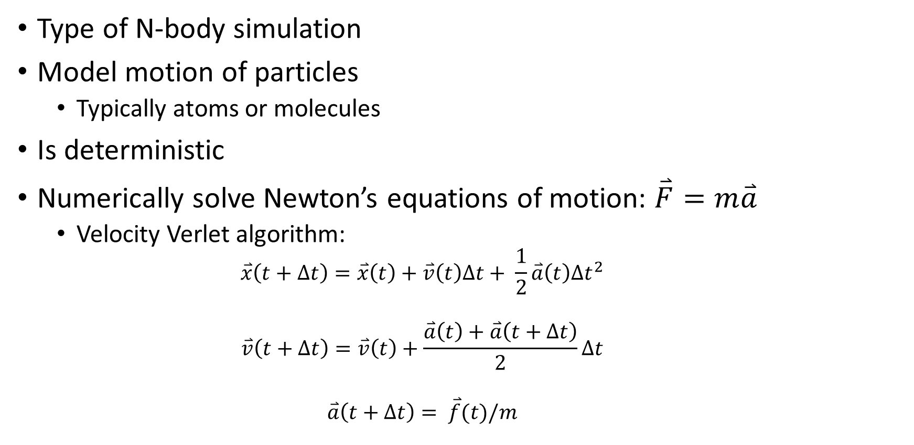
What is molecular dynamics?
Type of N-body simulation
Model motion of particles
Typically atoms or molecules
Is deterministic
Numerically solve Newton’s equations of motion: $\overset{⃑}{F}=m\overset{⃑}{a}$
Velocity Verlet algorithm:
$$\overset{⃑}{x}\left(t+Δt\right)=\overset{⃑}{x}\left(t\right)+\overset{⃑}{v}\left(t\right)Δt+ \frac{1}{2}\overset{⃑}{a}\left(t\right)Δt^{2}$$
$$\overset{⃑}{v}\left(t+Δt\right)=\overset{⃑}{v}\left(t\right)+\frac{\overset{⃑}{a}\left(t\right)+\overset{⃑}{a}\left(t+Δt\right)}{2}Δt$$
$$\overset{⃑}{a}\left(t+Δt\right)= \overset{⃑}{f}(t)/m$$

Slide 3
Some features of my implementation
Can save output to file and restart from file
Can display as interactive plot to show evolution over time
User has a lot of flexibility to set parameters
Forces currently very simple but could be modified
System can be finite or infinite
Can be periodic or nonperiodic
Let’s look at a simulation before discussing parallelism

Slide 4
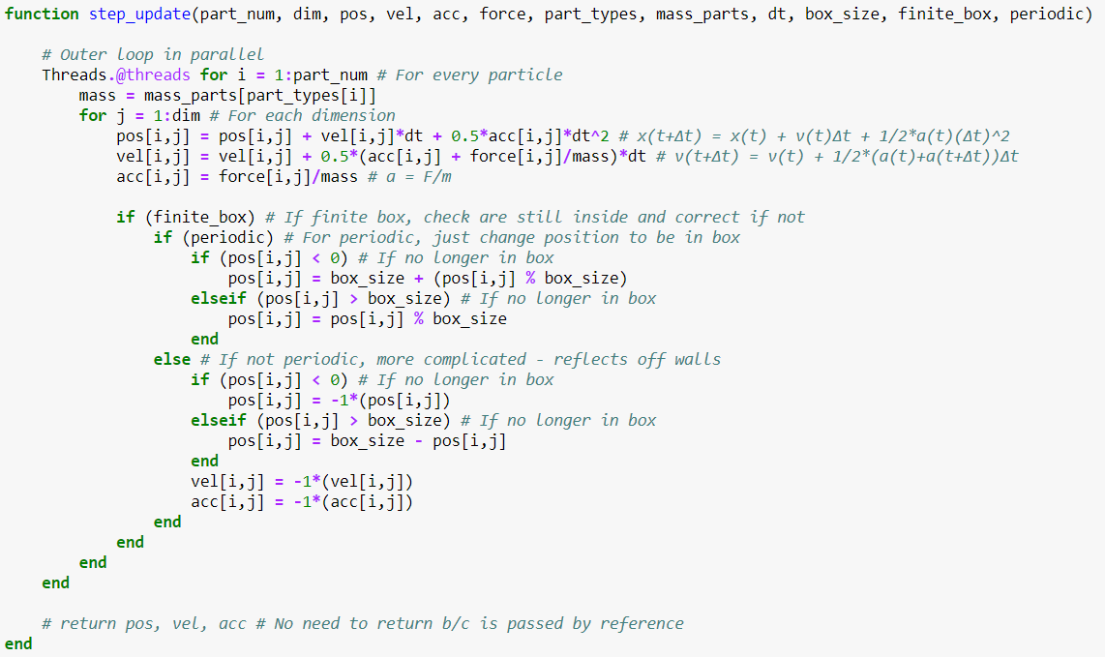
Parallel implementations: Threads.@threads
Threads.@threads macro to parallelize loops for Velocity Verlet algorithm and for updating forces

Slide 5
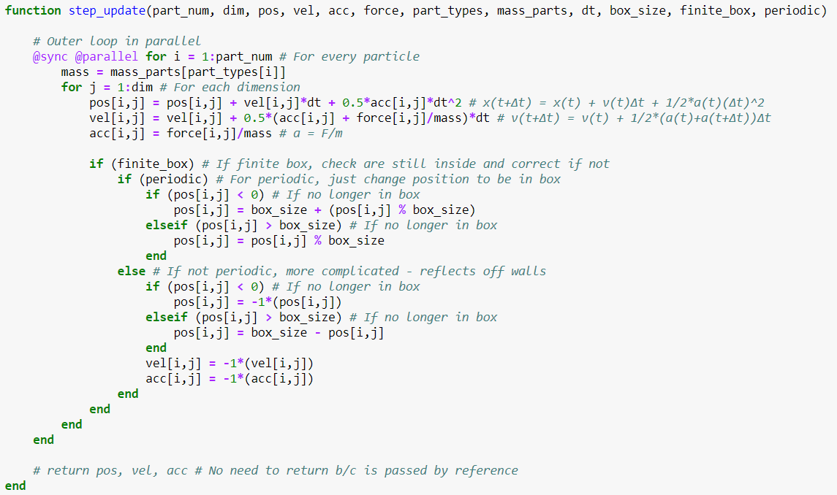
Parallel implementations: SharedArrays w/ @parallel
Used SharedArray data type for positions, velocities, accelerations, and forces
Each process/worker can access all of the array
Divide work using @sync @parallel macros

Slide 6
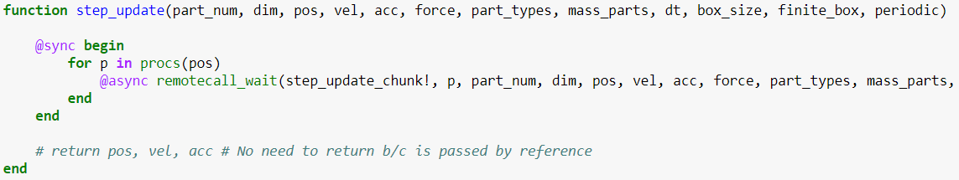
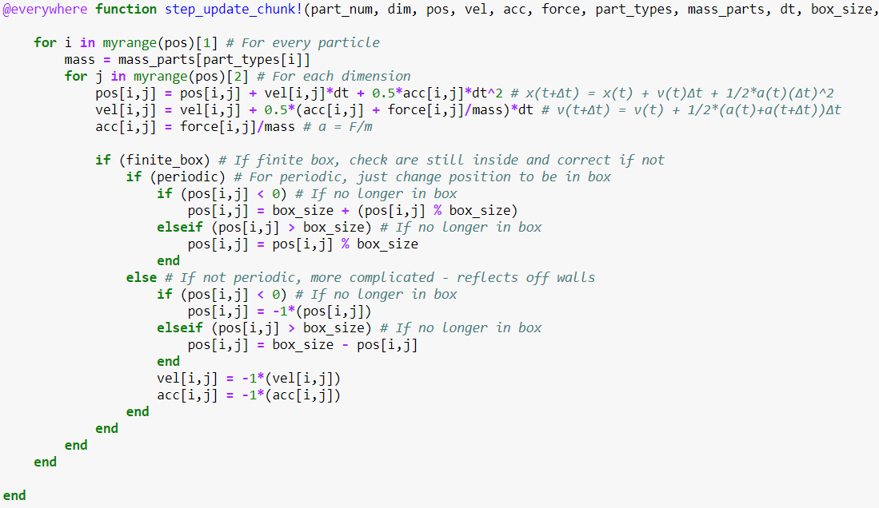
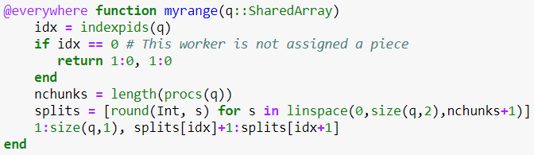
Parallel implementations: SharedArrays w/ chunks
Used SharedArray data type for positions, velocities, accelerations, and forces
Each process/worker can access all of the array
Divide work by splitting arrays into chunks with manual indexing

Slide 7
Timing using @benchmark

Slide 8
Conclusion
Threads.@threads is the best
Ran on CPU with 4 physical cores but with Intel hyperthreading
For 4 threads: About 3x speedup for all three particle numbers
For 8 threads: About 4x speedup for all three particle numbers
Neither of the SharedArray implementations is better than the serial version
Seems like a common problem (just from Googling it) but for various reasons
@parallel does see some speed up when 3 or 9 workers are used versus when 1 process is used
Fastest is 3 workers – makes sense b/c 9 workers is more than the number of threads
Fairly close to serial speed
Oddly, don’t see any change when number of threads are changed from 4 to 8
Would need to further experiment with number of threads and workers to find optimal configurations

